Slide 1
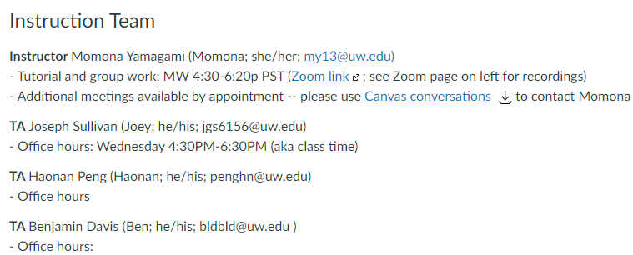
ECE 447: Control System Analysis (sp21) MW 4:30-6:20
Slide adapted from Burden, 2020

Slide 2
we will meet online only
pre-recorded lectures by Prof. Burden
meet during scheduled class time
Mondays: tutorial and office hours (Momona)
Wednesdays: group work (Momona and Joey) - do a portion of the HW together in groups → full credit if you try and attend class
I will be on Zoom at 4:20 if you want to come online early and chat
office hours: Haonan and Ben, TBD

Slide 3
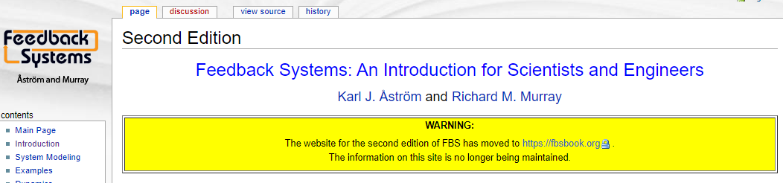
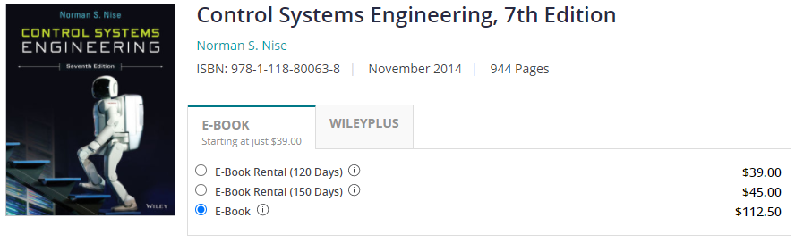
course materials and technology
Canvas page --> lectures, HW / group work, exam assignments, lecture material
discord
Python
Textbook: none

Slide 4
conduct
helpful to say your name before you speak
video on would be super awesome if possible but not necessary
feel free to unmute or type questions into the chat
please be kind and respectful to each other and to your instruction team during or outside of class
(eg on discord – please change your nickname to preferredName (preferredPronouns))
our instruction will be flexible and actively check in you all

Slide 5
today
canvas overview – join discord! and change your nickname to preferredName (preferredPronouns)
course overview
Python programming

Slide 6
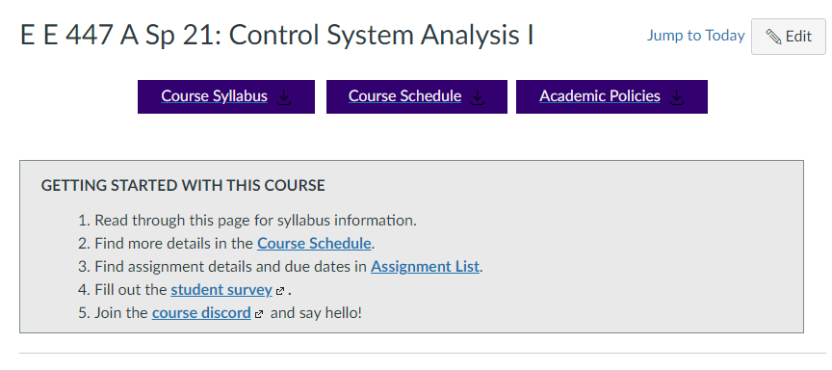
https://canvas.uw.edu/courses/1448963
Notes:
accessibility

Slide 7
ECE 447: Control System Analysis (sp21) MW 4:30-6:20
why take this course?

Slide 8
this course focuses on analysis and design of (linear) feedback control systems.
you will learn to understand and engineer control in robotics, embedded systems, electrical circuits, power systems, and biology.
we’ll build on your background in calculus, signal processing, and linear algebra, providing new analytical and computational tools.

Slide 9
learning outcomes
by the end of this course, you will be able to:
represent a linear system in state space and transfer function form;
determine the effects caused by including feedback in a system;
linearize a nonlinear system around an operating point;
determine if a system is stable;
understand sensitivity and noise/disturbance rejection properties;
apply scientific computing tools to model, design and simulate systems;
determine the performance of a system analytically and from simulation;
apply root locus, frequency response and full-state feedback methods to design a feedback control system to meet performance requirements;
design a full-state observer for a system;
apply observer + controller to estimate and stabilize a system’s state.

Slide 10
origins of feedback control

Slide 11
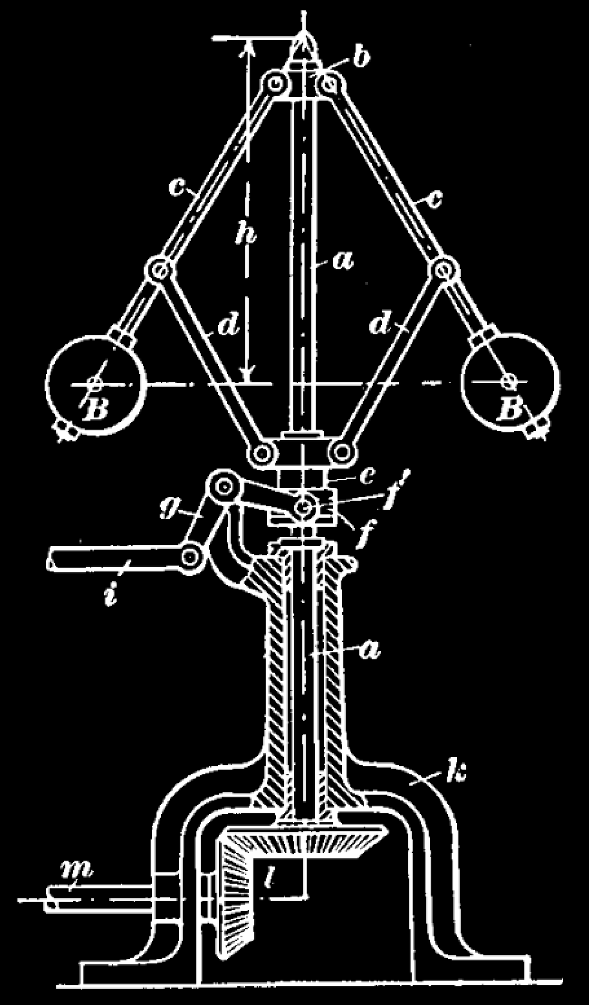
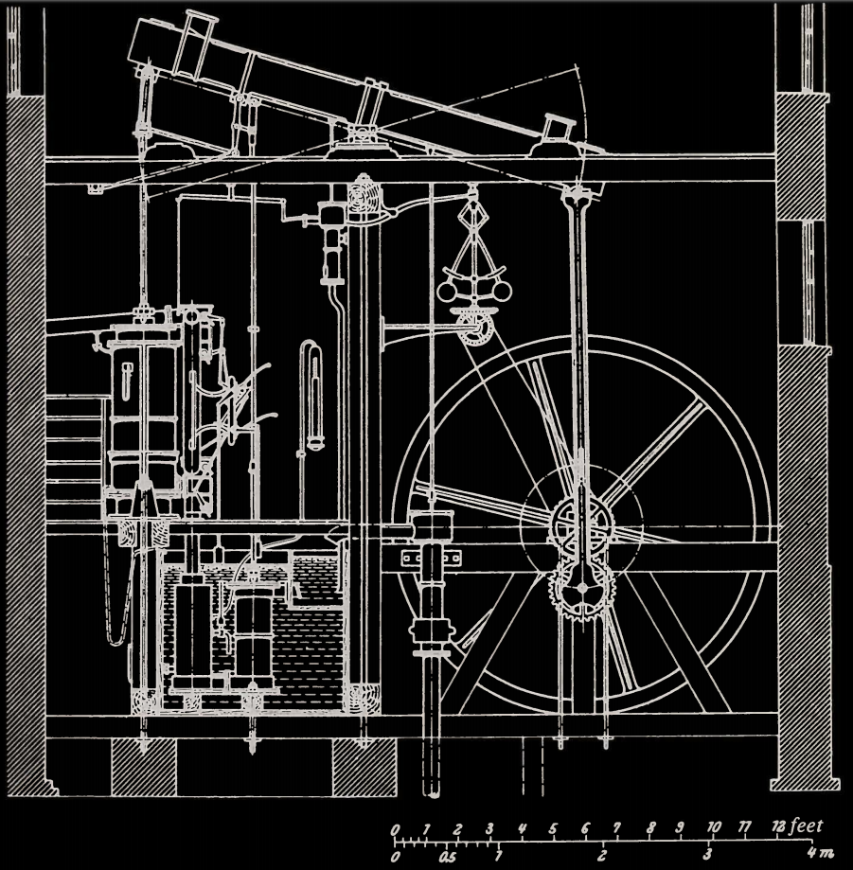
flyball governor ~1800s
balls fly out as speed increases
regulate speed of steam engine
reduce effect of variations in load (disturbance rejection)
fueled industrial revolution
valve closes, slowing engine
Boulton-Watt Steam Engine
Mayr, Otto. "The origins of feedback control." Scientific American 223.4 (1970): 110-119.
Åström, Karl Johan, and Richard M. Murray. Feedback systems. Princeton university press, 2010.
Slide adapted from Murray, 2004

Slide 12
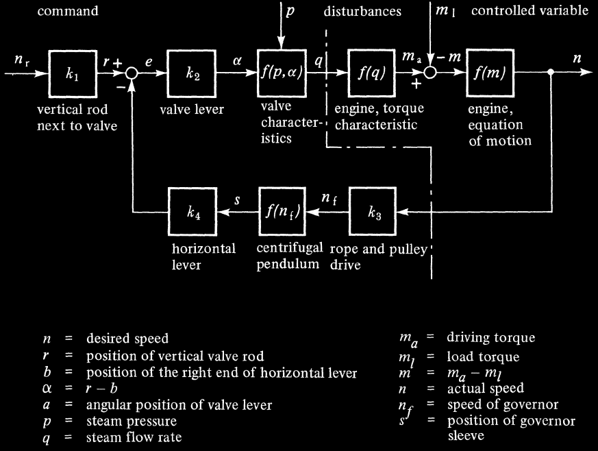

Slide 13
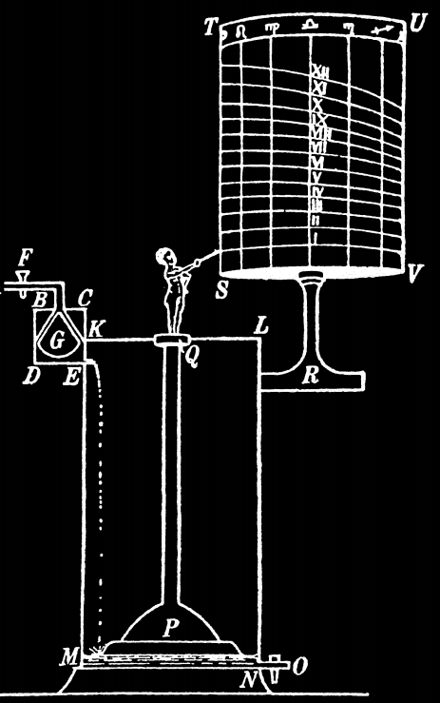
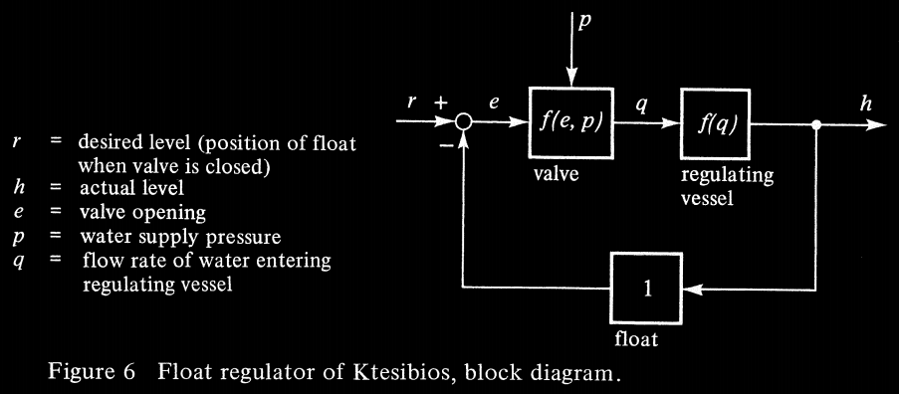
float valve ~300 BC
maintain water at a constant level
Mayr, Otto. "The origins of feedback control." Scientific American 223.4 (1970): 110-119.
Åström, Karl Johan, and Richard M. Murray. Feedback systems. Princeton university press, 2010.
Slide adapted from Burden, 2020

Slide 14
state of the art

Slide 15
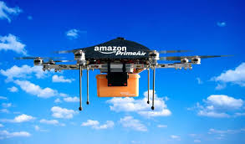
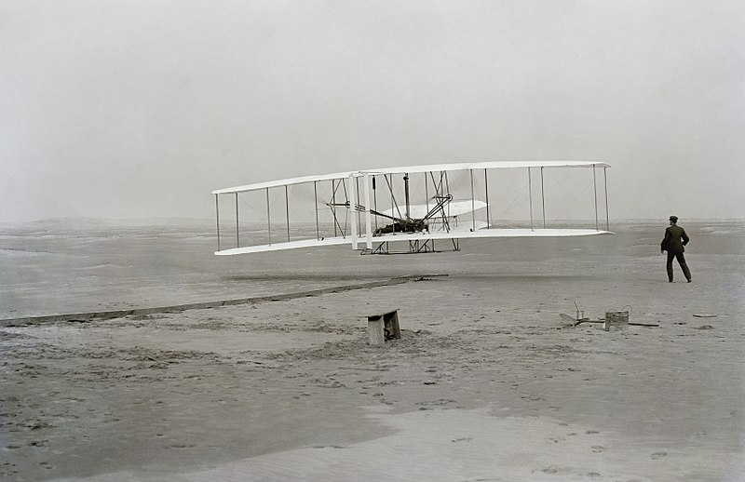
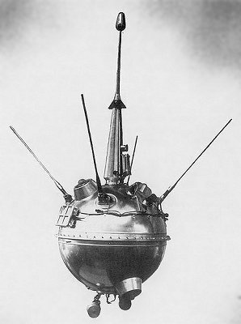
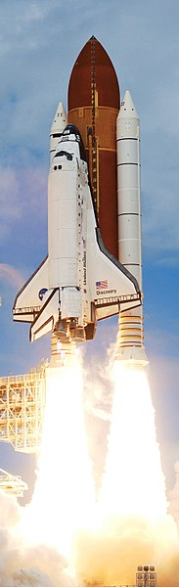
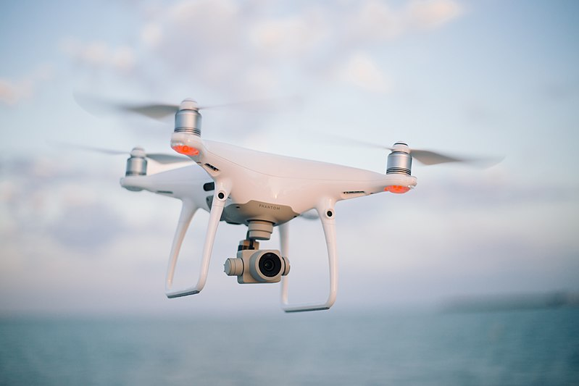
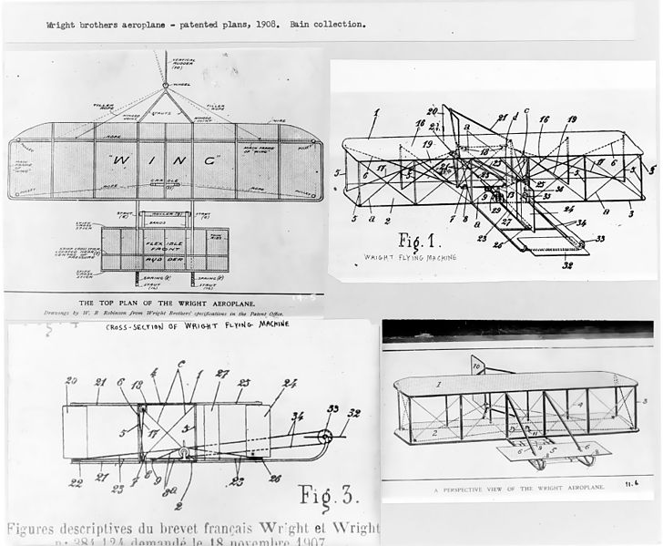
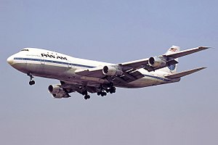
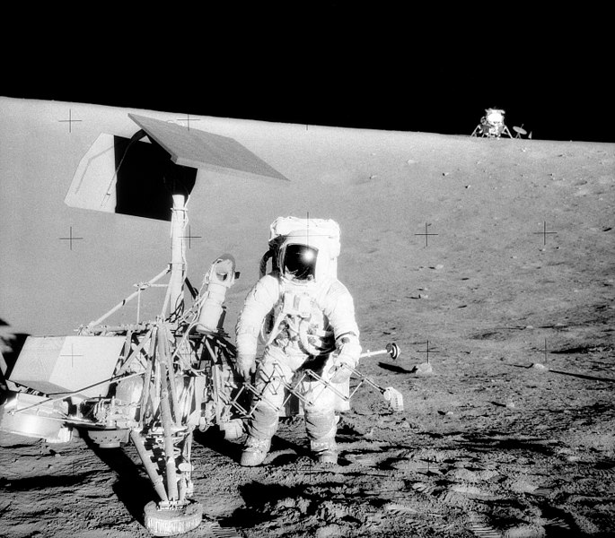
aerospace and transportation
first aircrafts not stable, so continuous pilot corrections were needed
current research: control of distributed machines

Slide 16
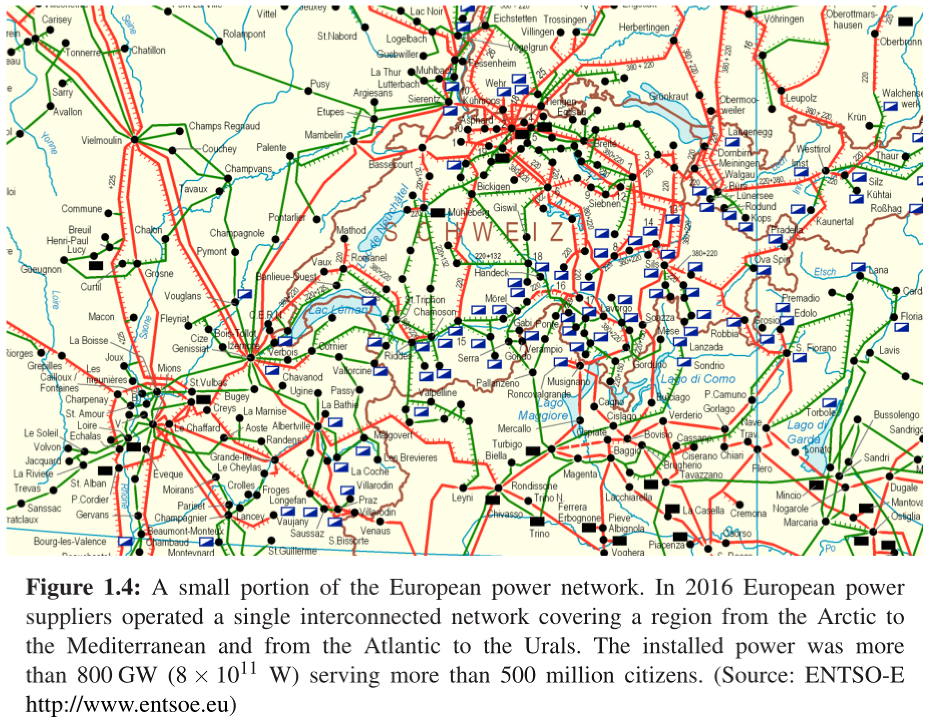
power systems – ECE 458
generation and distribution of electrical power
control is critical to match production to consumption

Slide 17
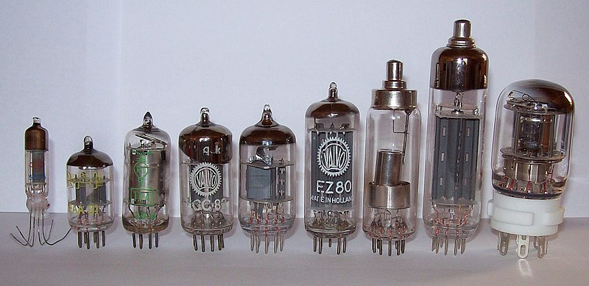
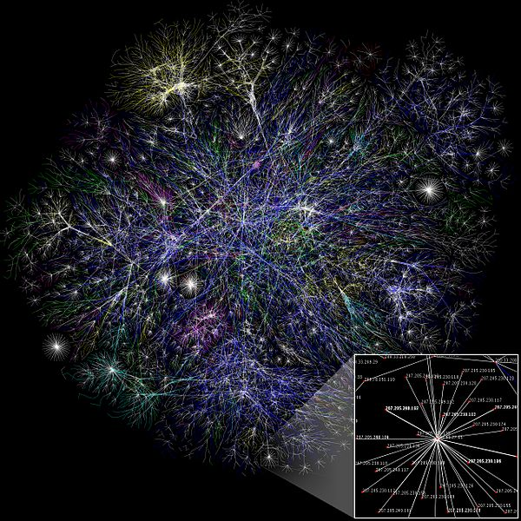
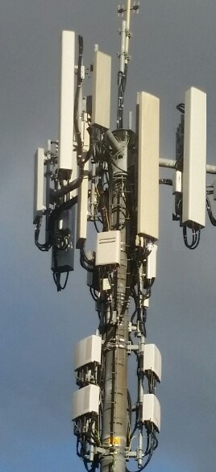
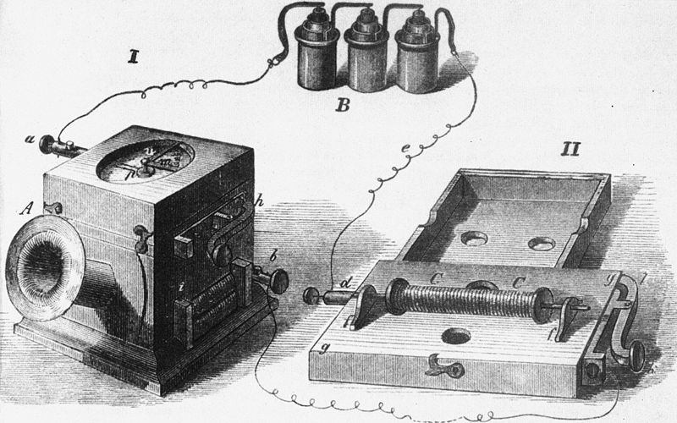
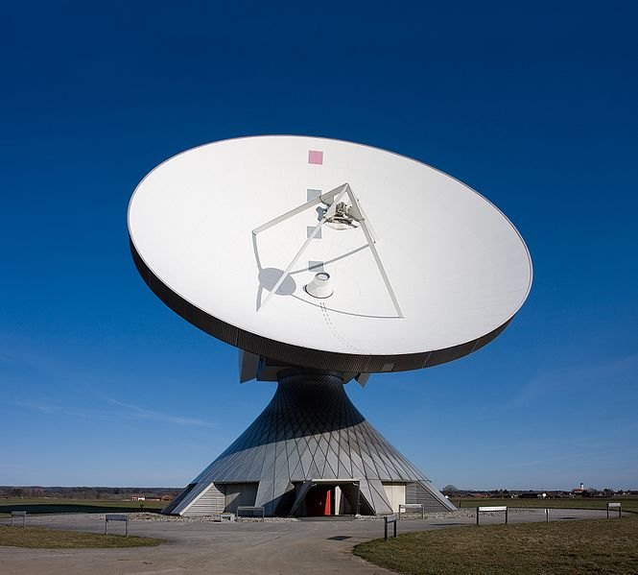
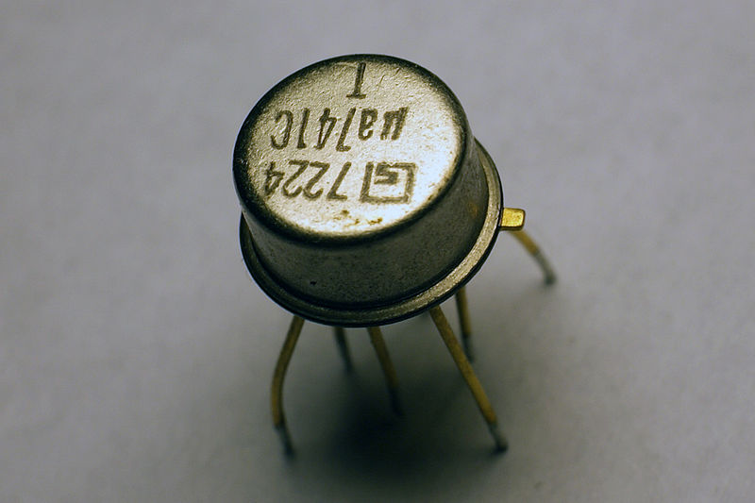
telecommunication
signal amplification for telecommunication → negative feedback amplifier
feedback is used extensively in cellular phones and networks

Slide 18

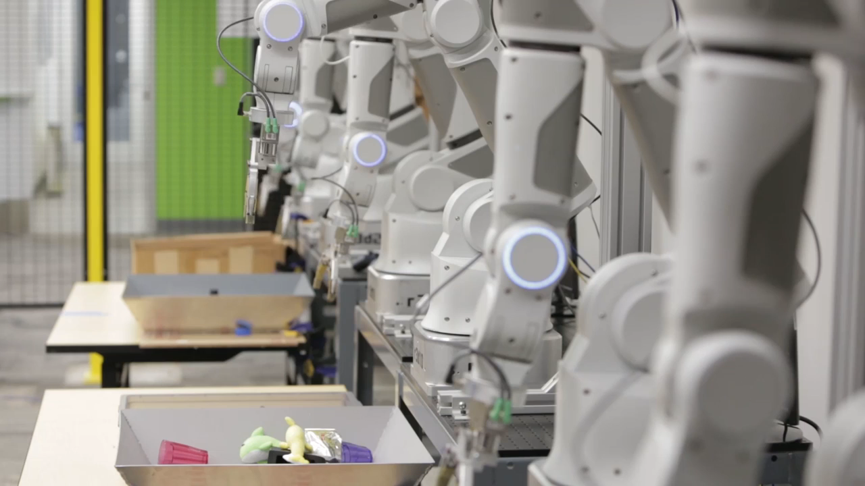

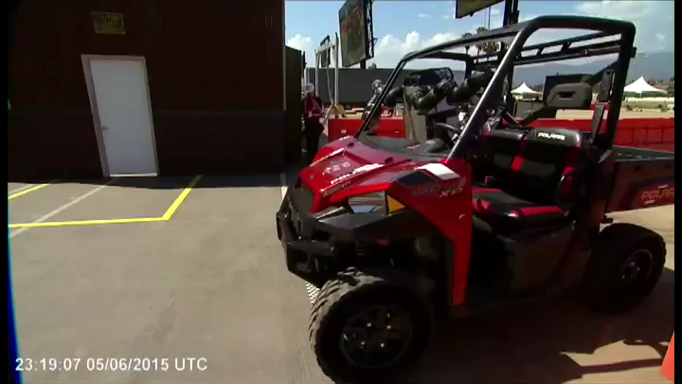
robotics and AI - ENGINE
perceive environment and use control algorithms to navigate

Slide 19
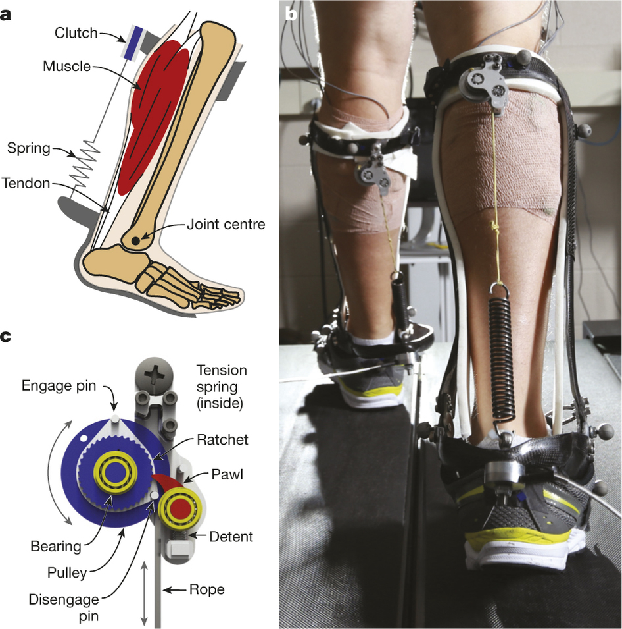
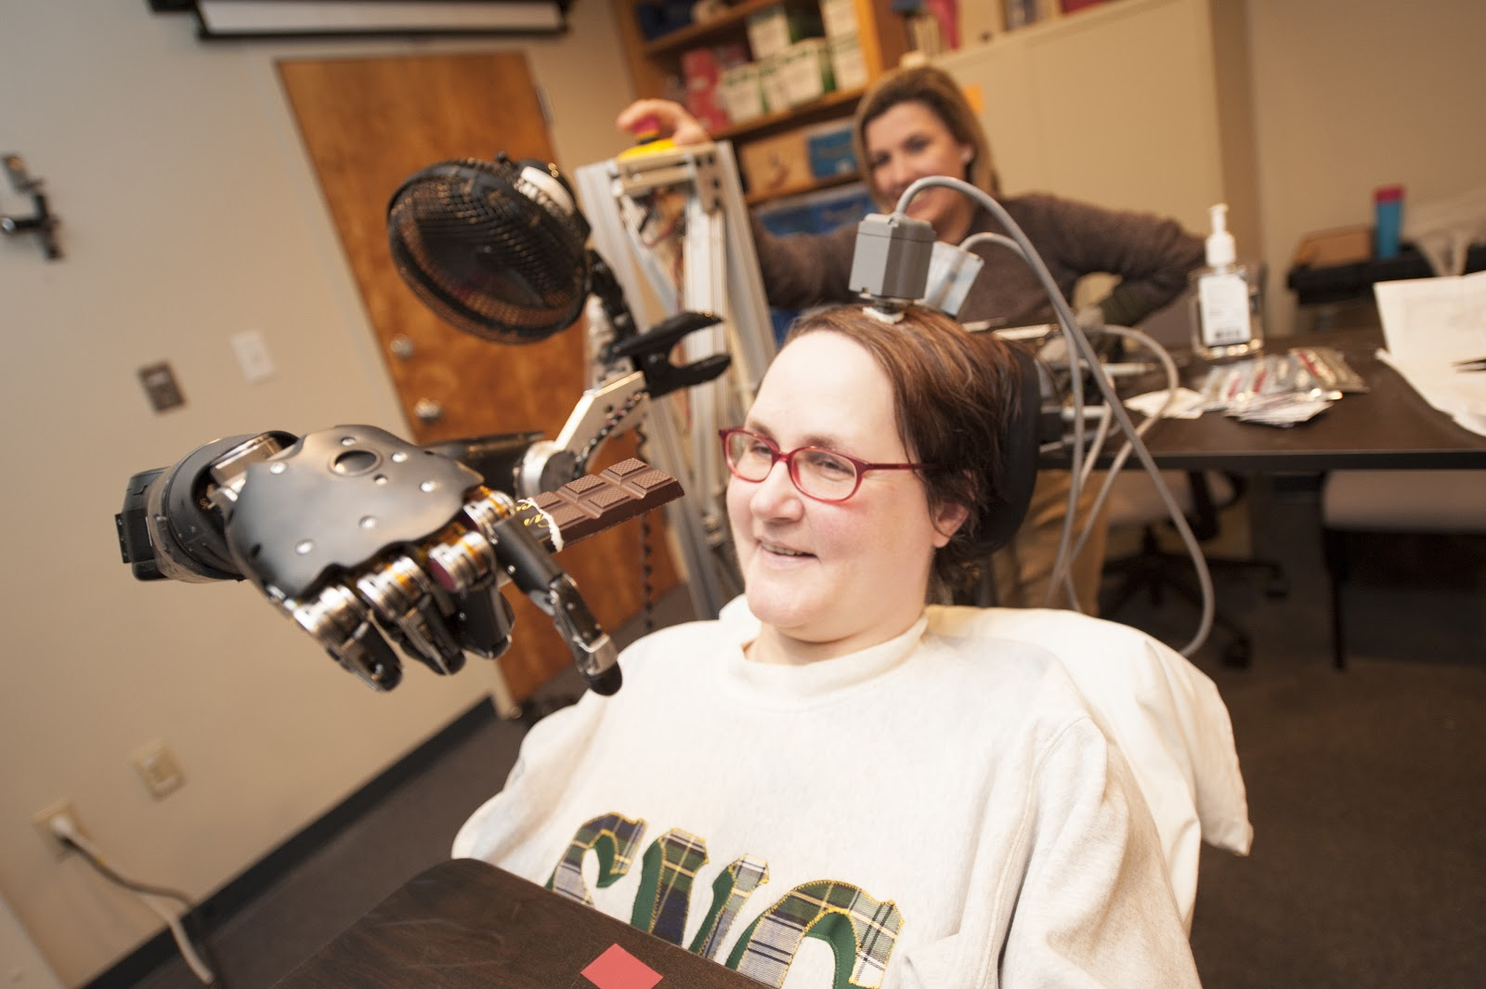
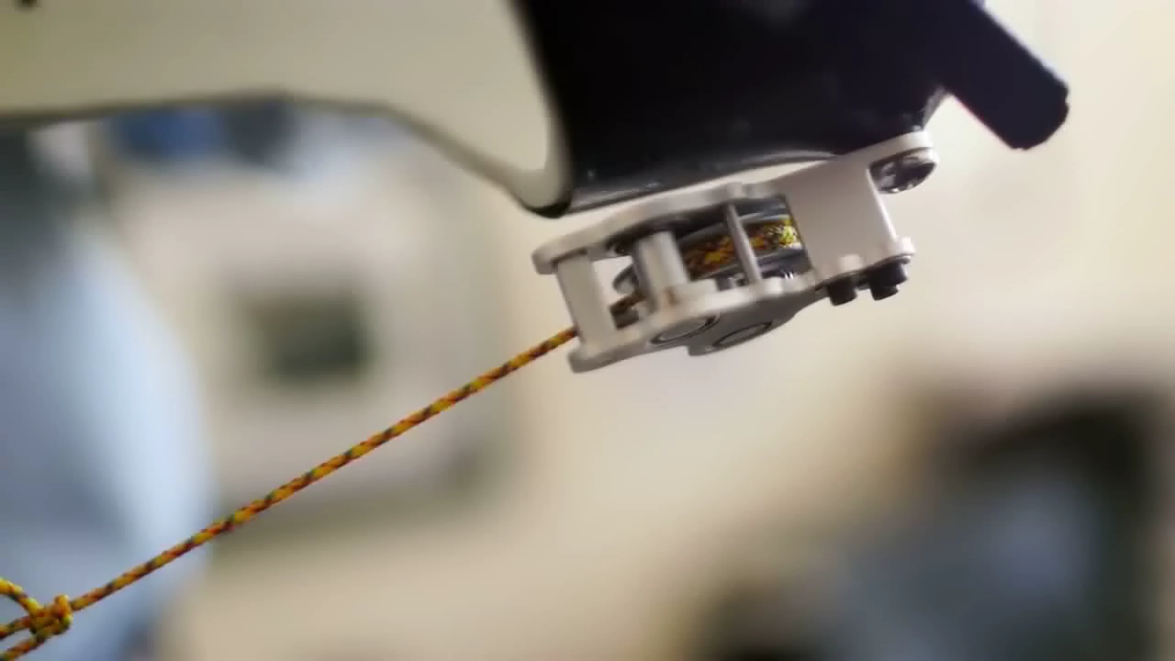
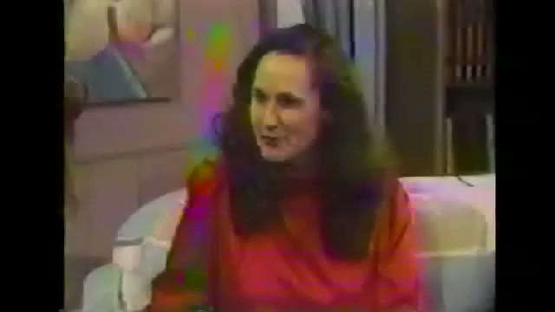
neuroengineering – ECE 466
model human and robot as control system

Slide 20
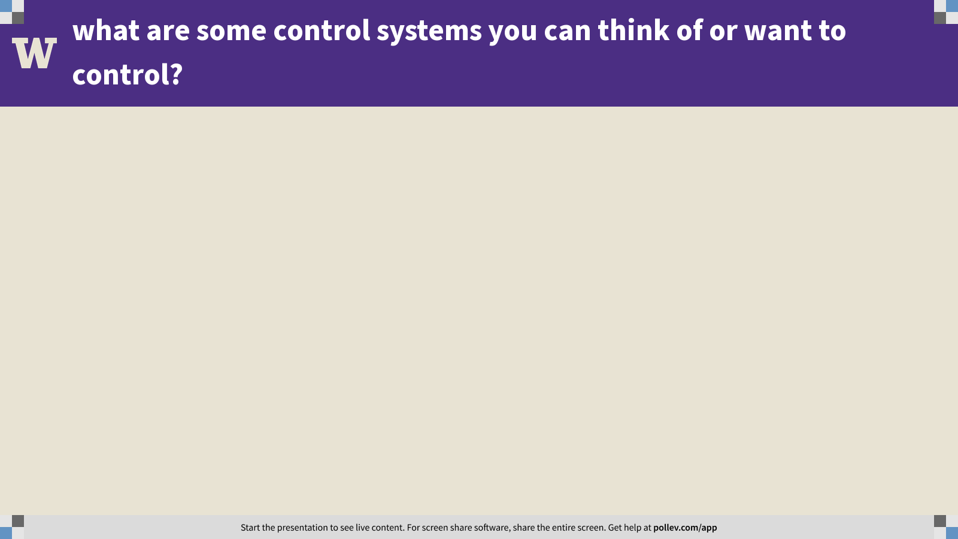
Notes:
Poll Title: what are some control systems you can think of or want to control? https://www.polleverywhere.com/free_text_polls/wO0AApzLwitL2j6fhVDtr

Slide 21
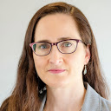
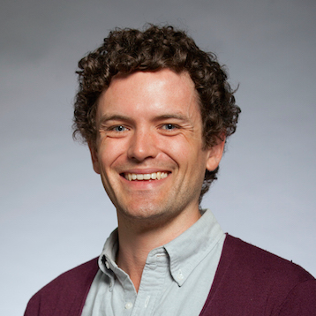
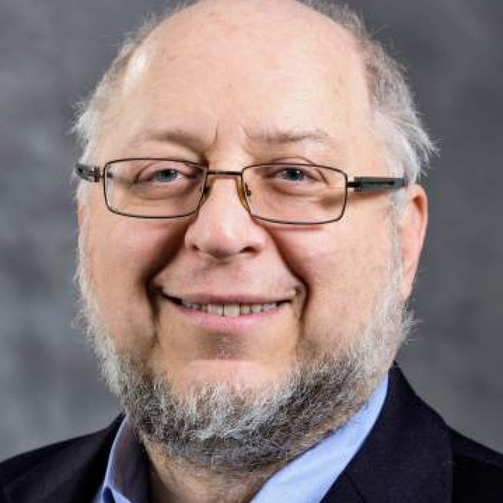
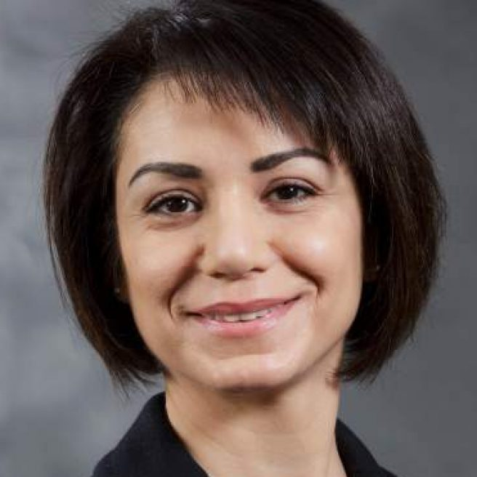
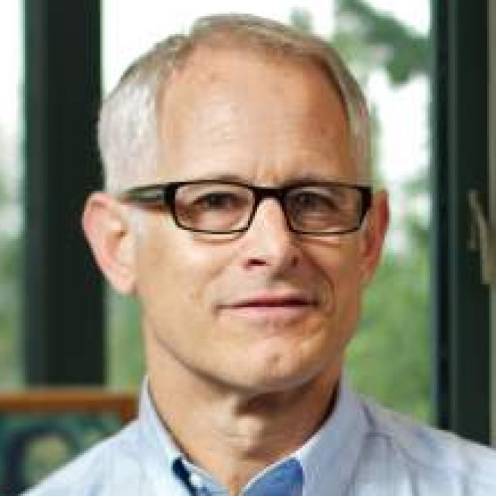
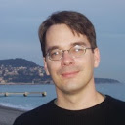
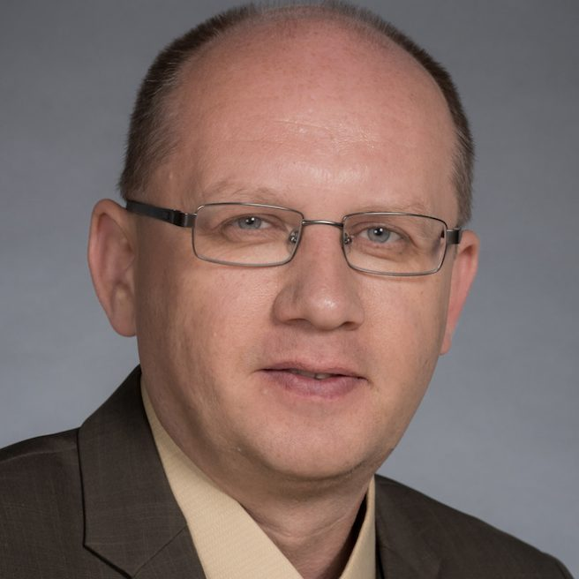
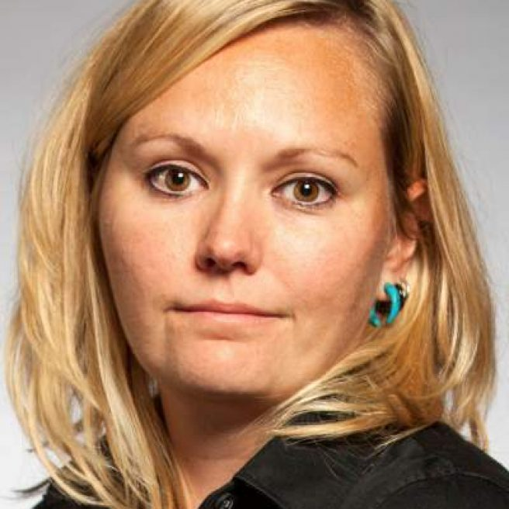
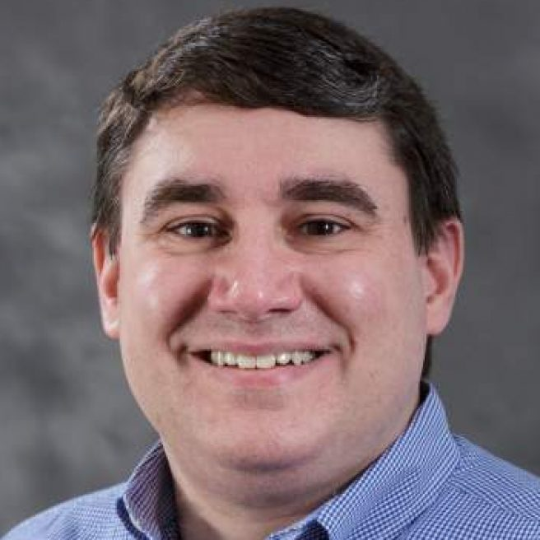
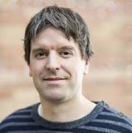
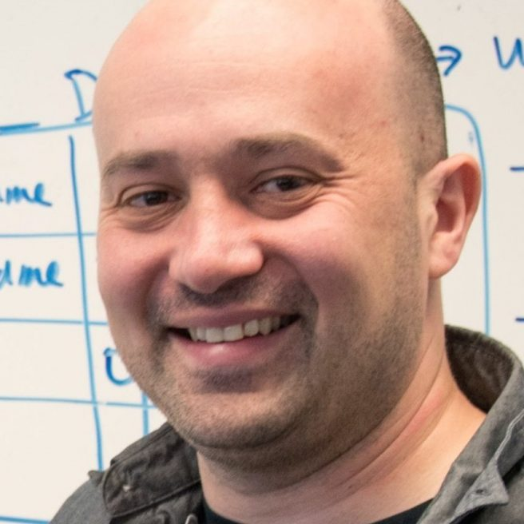
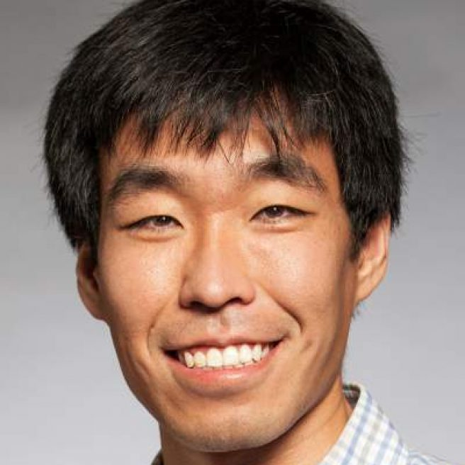
ECE systems / controls / robotics
Prof. Linda Bushnell | networked control, cyber security
Prof. Sam Burden | sensorimotor control
Prof. Howard Chizeck | brain-computer interface (BCI)
Prof. Maryam Fazel | convex optimization
Prof. Blake Hannaford | medical robotics, telerobotics
Prof. Eric Klavins | systems biology
Prof. Alex Mamishev | sensor design and integration
Prof. Lillian Ratliff | cyber-physical systems (CPS)
Prof. Matt Reynolds | ultra-low power sensing, computation
Prof. Georg Seelig | systems biology
Prof. Eli Shlizerman | data-driven dynamical systems
Prof. Baosen Zhang | cyber-physical systems (CPS)

Slide 22
break!!
when we come back….python!

